Slide 1

Group 7
Brooklyn Hounsell, hristina sotirova, Samuel filby, victor sicoe

Slide 2
BRIEF
Single player game
Emphasis on a single mechanic
Develop a game without the main mechanic
Substitute and refine the main mechanic

Slide 3
TARGET DEMOGRAPHIC
Non-casual male players
Teenagers & young adults
15 – 30 years old
Players who prefer a challenge

Slide 4
OUR SOLUTION TO THE BRIEF
Twitch based game
2D top-down shooter
Replaced the shooting mechanic with deflection
Desired emotions
Frustration
Relief
Tension
Fiero

Slide 5
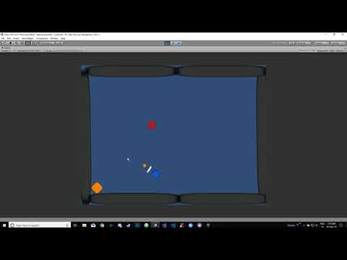
WALKTHROUGH VIDEO
GameplayHere

Slide 6
FINAL PRODUCT
Animations for player & enemies
4 types of enemies & 1 boss type enemy
Editable room layouts
Particle effects
Audio
UI assets
Tilemaps

Slide 7
QUESTIONS?

